Slide 1
IntroDUCKtions and Course Overview
PRV-101 | First Year Experience Course Fall 2024
Week 1

Slide 2
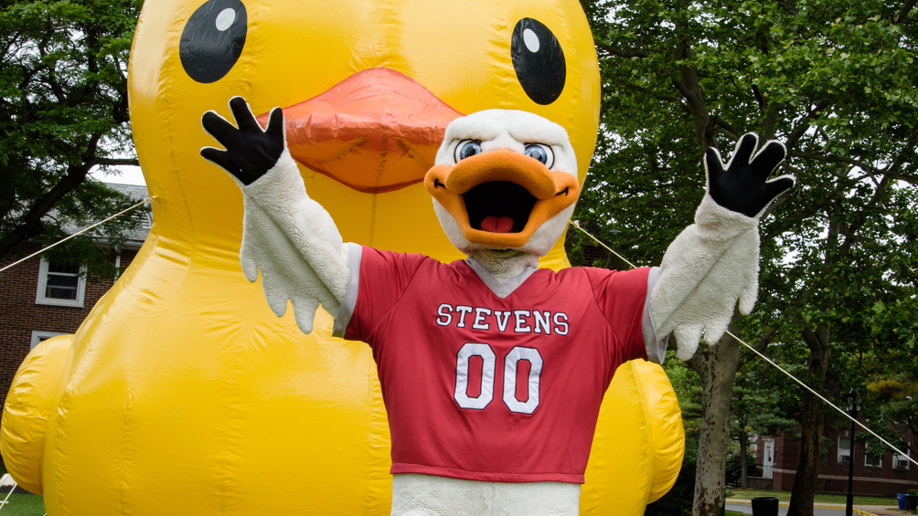
Welcome and Introductions

Slide 3




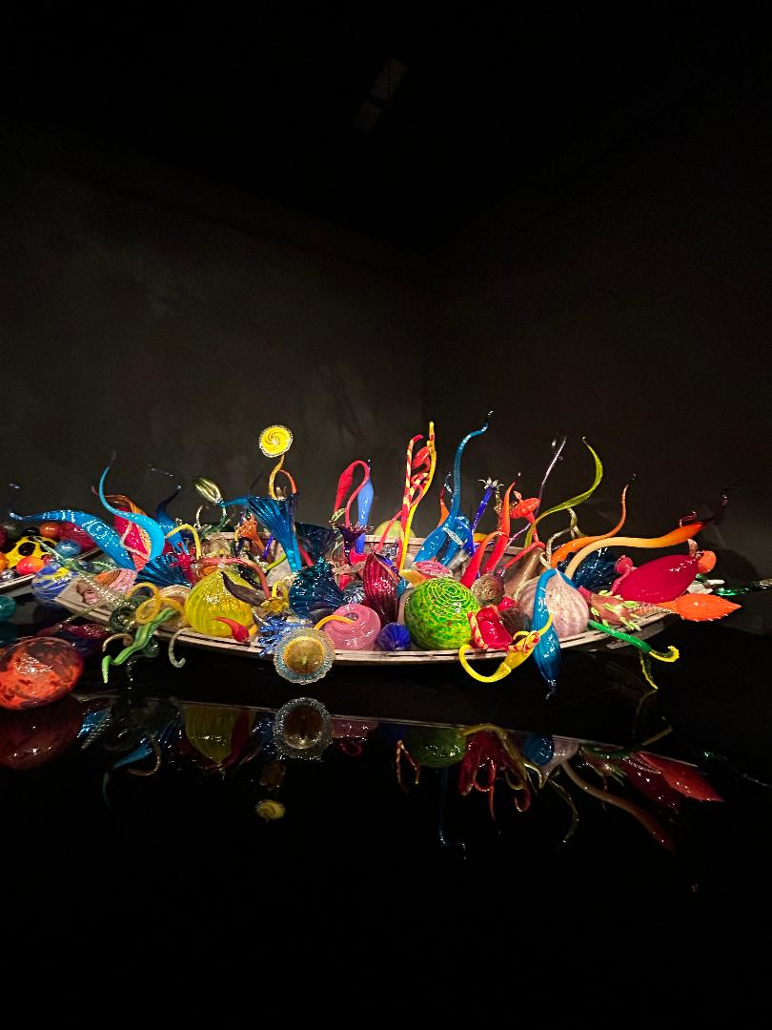
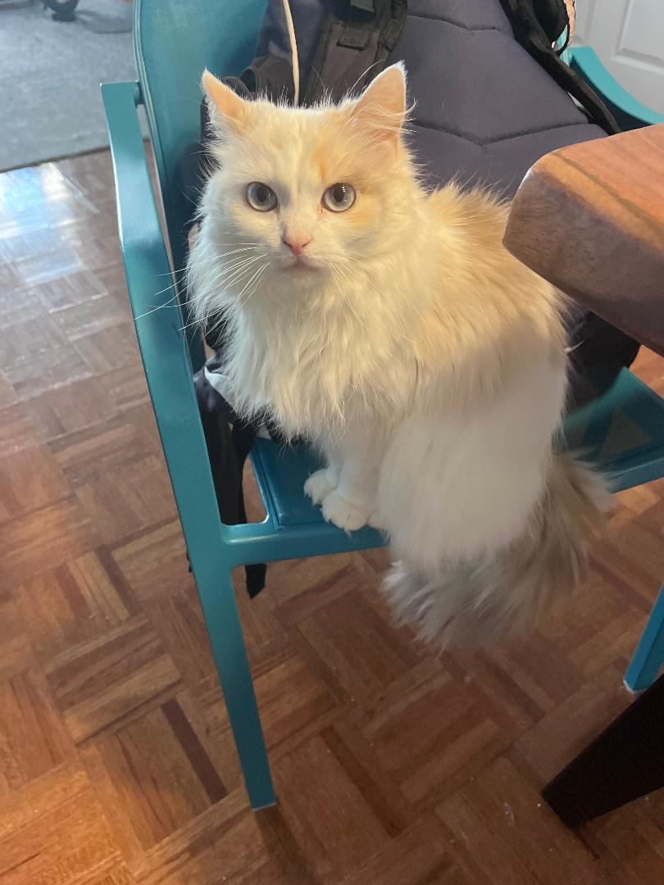
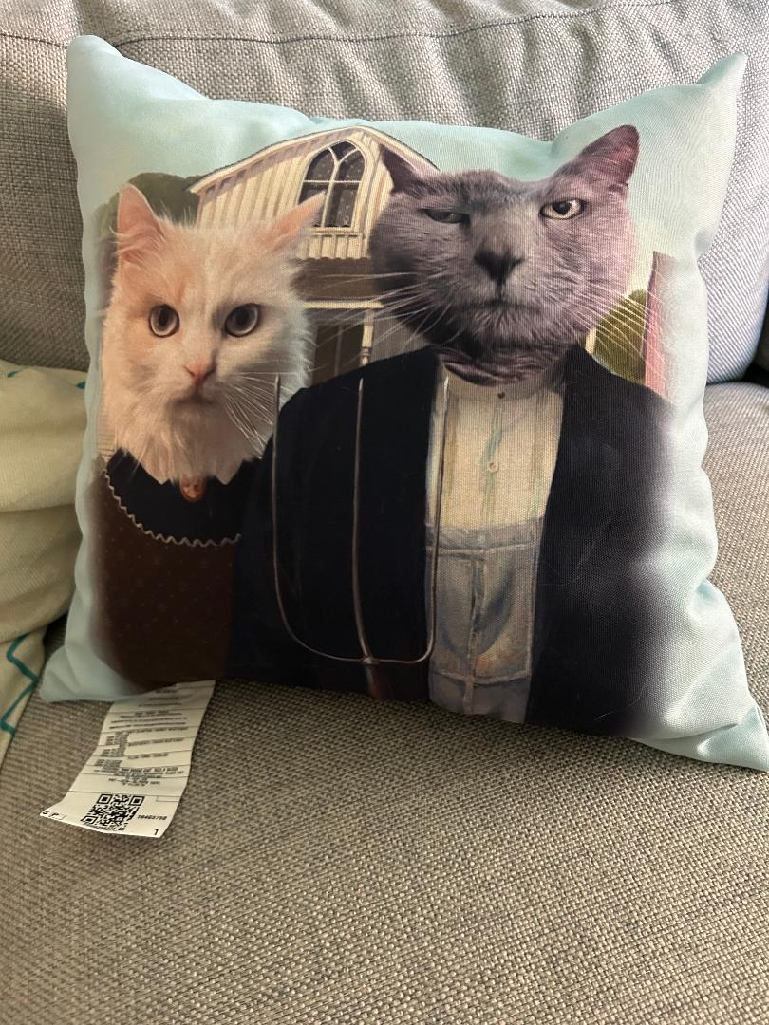
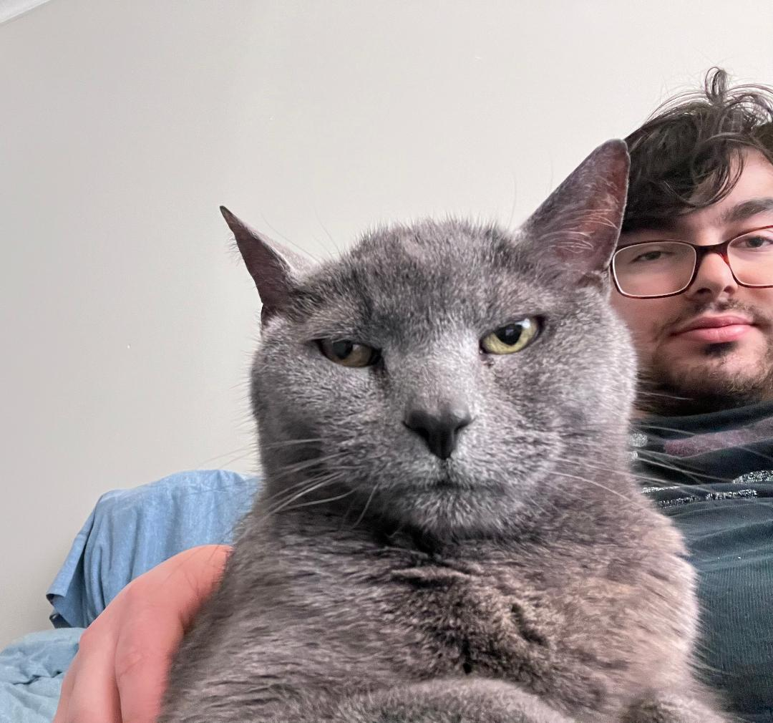
Instructor Introduction – Dean and Professor Eve Riskin​
Notes:
Eve

Slide 4


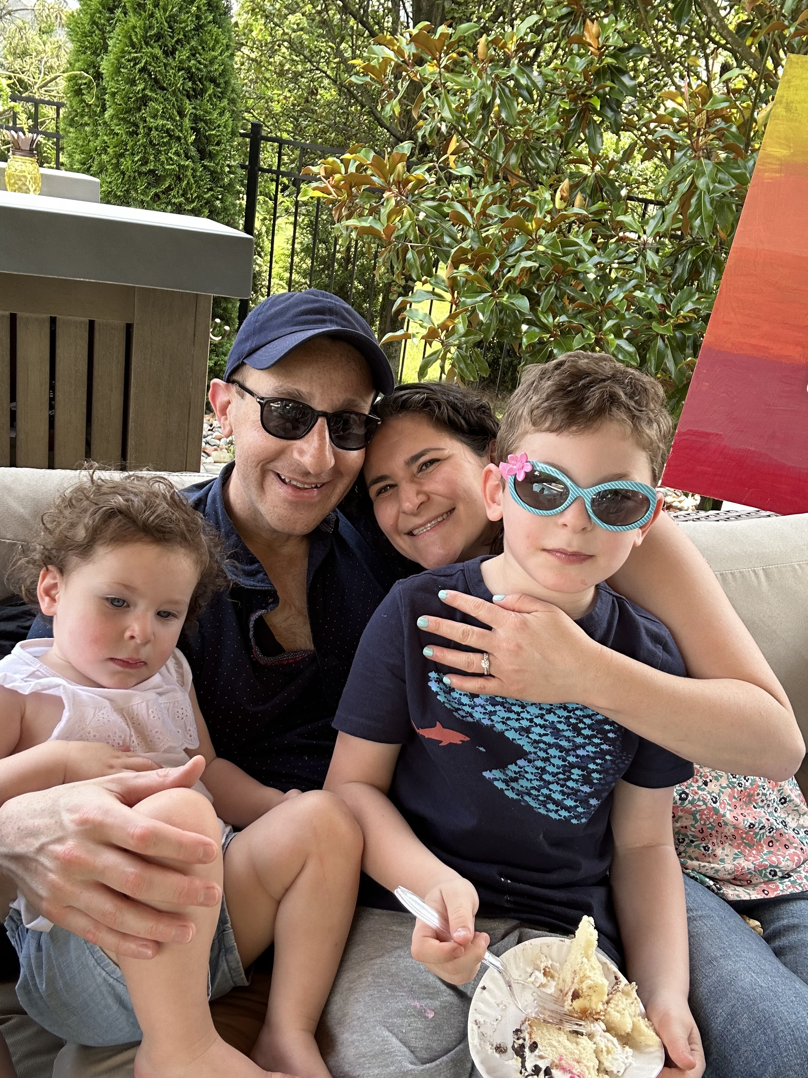

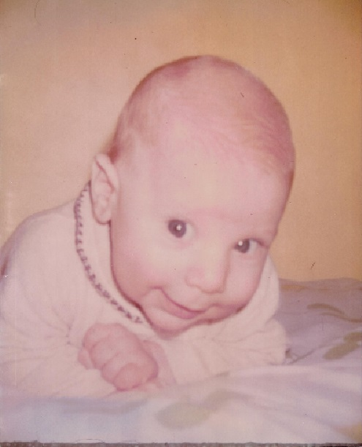
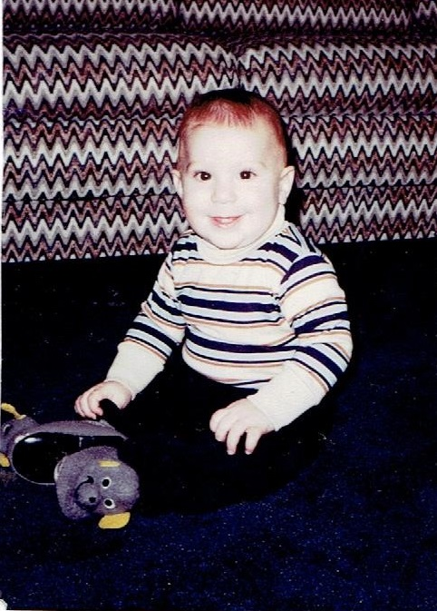




Instructor Introduction – Dr. Eric Rose

Slide 5

Today's Objectives
At the end of this session, students will:
Be able to articulate the value of community and identify their role within it by engaging in discussions and sharing personal "Lollipop Moment" experiences.
Gain a clear understanding of the course structure, expectations, and how it will contribute to their academic and personal development during their first semester.

Slide 6

Student Introductions
Students will share their name, pronouns, major and one first or favorite with the class as part of their introduction.
Firsts
Favorites
First Job: What was your first job and what did you learn from it?
First Concert: What was the first concert you ever attended?
First Travel Experience: Where did you first travel outside of your home city/state/country?
First Book You Loved: What was the first book you remember loving?
First Day of School: What do you remember about your first day of school ever?
First Friend: Who was your first friend and how did you meet?
First Major Achievement: What was the first major achievement or award you received?
Favorite Movie: What is your all-time favorite movie and why?
Favorite Book: What is your favorite book and what do you love about it?
Favorite Hobby: What is your favorite hobby or pastime?
Favorite Place to Visit: What is your favorite place to visit, why?
Favorite Song: What is your favorite song and how does it make you feel?
Favorite Season: What is your favorite season of the year and what do you enjoy most about it?
Favorite Quote: What is your favorite quote and what does it mean to you?

Slide 7

Your Lollipop Moment
https://www.ted.com/talks/drew_dudley_everyday_leadership?subtitle=en
Notes:
Ask students what their lollipop moment that has made a difference in their life? What is one thing they can do this semester for others?
https://www.ted.com/talks/drew_dudley_everyday_leadership?subtitle=en

Slide 8
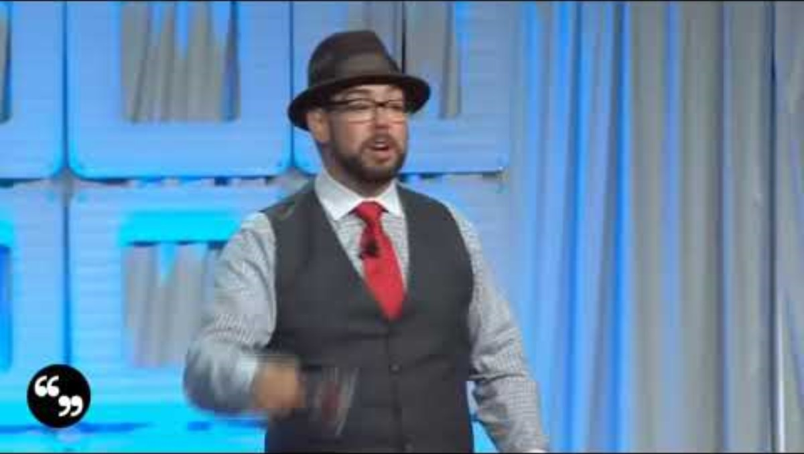

Slide 9


Slide 10

Why These Moments Matter
Empowerment through Recognition:
They highlight the profound impact that small, seemingly insignificant actions can have on others, empowering individuals to recognize their potential to influence positively.
Foster Leadership:
Lollipop moments encourage a broad definition of leadership, showing that leadership is not only about monumental achievements but also about everyday interactions and kindness that everyone can do.
Build Connections:
These moments often lead to lasting connections, strengthening bonds and enhancing interpersonal relationships within groups.
Promote Self-Awareness:
They help individuals realize the unintended impacts of their behaviors, fostering greater self-awareness and mindfulness in daily interactions.
Understanding and discussing the "Lollipop Moment" concept allows you to appreciate the power of everyday actions and feel empowered to contribute positively to your community.

Slide 11
Syllabus Review

Slide 12
Course Objectives
Build Connections: Form meaningful relationships with peers, faculty, and staff by actively participating in activities and discussions as part of the course.
Transition Strategies: Develop and apply effective strategies tailored to navigate the unique challenges transitioning from high school to college, including understanding new academic expectations and social dynamics.
Resource Navigation: Identify and utilize a range of campus resources, such as academic advising, student support services, counseling services, and others to enhance their academic and personal success.
Academic Success Skills: Adopt academic strategies including effective time management, advanced study techniques, and robust organizational skills to improve study habits and coursework management.
Career and Financial Skills: Demonstrate a thorough understanding of career development processes, engage in financial literacy education, and explore global citizenship concepts to prepare for future professional and personal decisions.
Inclusive Dialogue: Engage in and promote respectful, inclusive dialogue and civil discourse within the classroom and broader campus community, appreciating diverse perspectives and fostering an inclusive environment.
Personal Wellness Awareness: Identify key issues related to personal wellness and mental health that are prevalent among first-year students; develop strategies to manage these challenges effectively.
Community Engagement: Actively participate in the Stevens community through involvement in campus events, clubs, and organizations, thereby cultivating a strong sense of belonging and pride in their institution.

Slide 13
Syllabus Highlights
Flipped Classroom
Watch weekly videos on Canvas before class
Will be referenced during class
Atilla's Assignments
Also known as ELAs and are opportunities to engage with campus
Need to be completed by Week 4, 8 and 14 and uploaded to Canvas
Grading
Pass/Fail
Class Participation and Attendance- 60%
Experiential Learning Activities (ELAs)- 40%

Slide 14
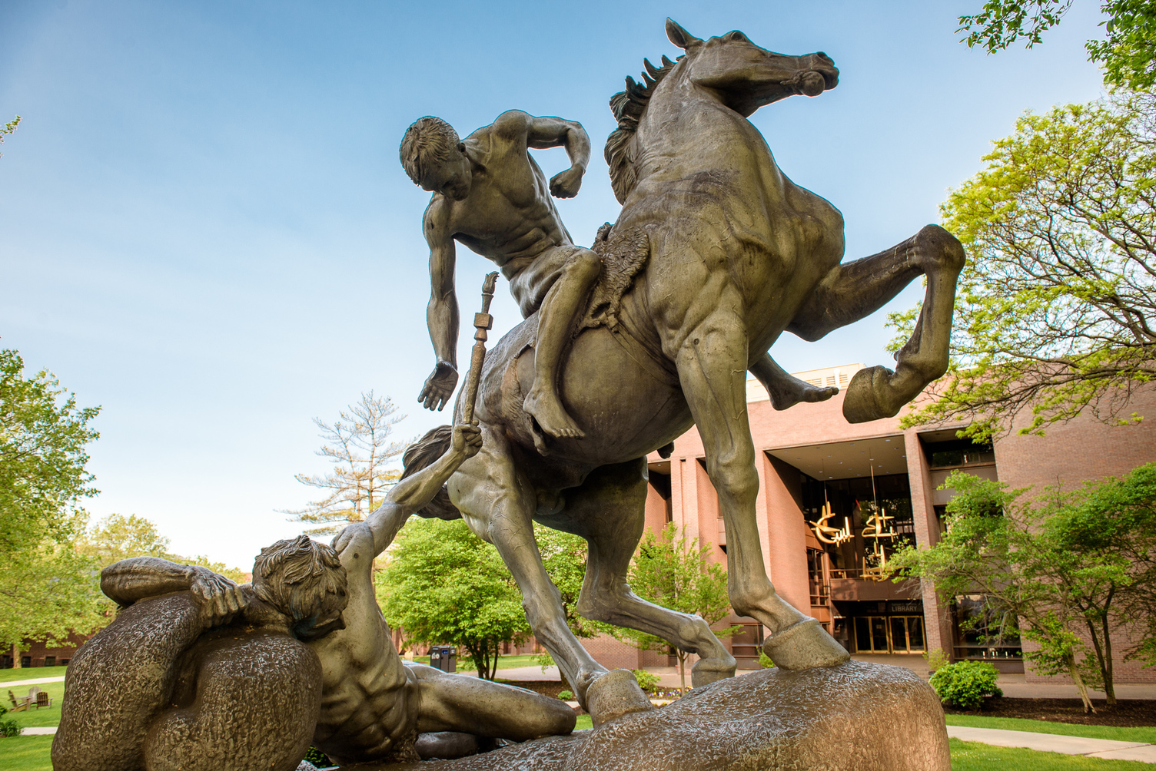
Torchbearer Takeaways
Understanding Impact: In the context of FYE, this concept is crucial for you as new college students navigate building relationships with peers, faculty, and staff. It helps students recognize that their actions, no matter how minor they seem, can profoundly affect the community around you.
Empowerment in New Environments: The video’s message that everyone has the potential to be a leader in everyday situations reinforces this empowerment, encouraging you to take initiative and engage fully from the onset of your college experience.
Fostering a Supportive Community: One of the goals of FYE is to foster a supportive and inclusive community. The "Lollipop Moment" video can inspire you to be more mindful and considerate, understanding that your words and actions can support and uplift others.
Reflective and Personal Growth: FYE encourages you to reflect on your personal growth and development. The video prompts you to think about moments when others have impacted their lives and how they, in turn, can affect others.

